Slide 1
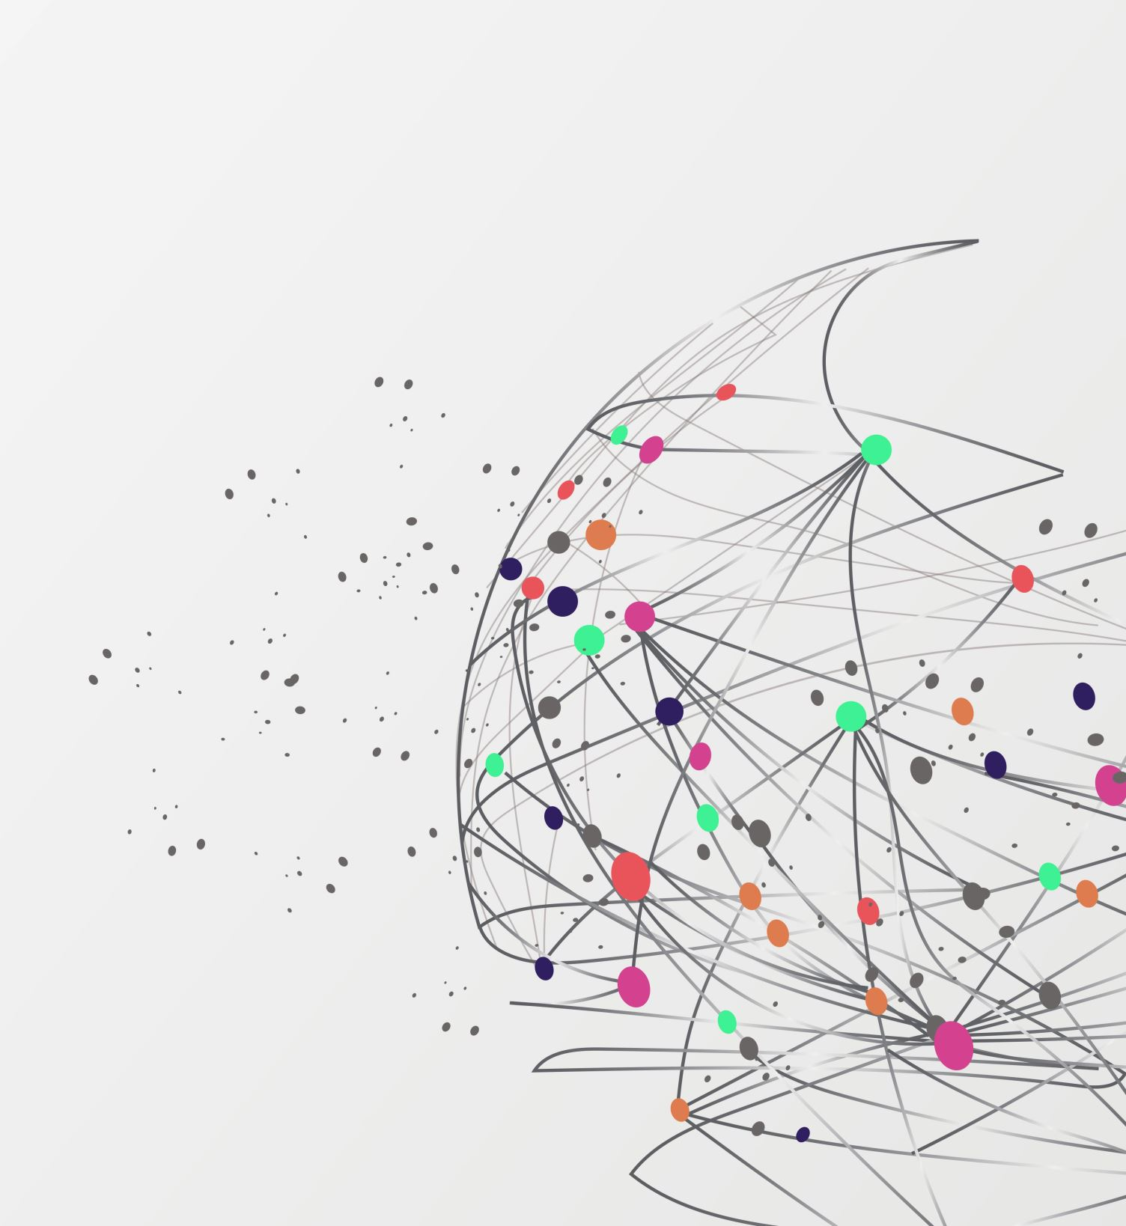
Fresh Food Supply Network Simulation
Kinjal Shah
Candice Chen

Slide 2
What ? Idea:
Feeding America Organisation (feedingamerica.org)
Statistics
Fresh Produce Matchmaker
Reduce Waste
Freshness of different food types

Slide 3
What ? Idea:
Feeding America Organisation (feedingamerica.org)
Statistics :
The USDA estimates that approximately 7.3 billion pounds of produce is wasted in the U.S. each year. The Feeding America network of 200 food banks would like to see more of those fruits and vegetables go to neighbors in need.

Slide 4
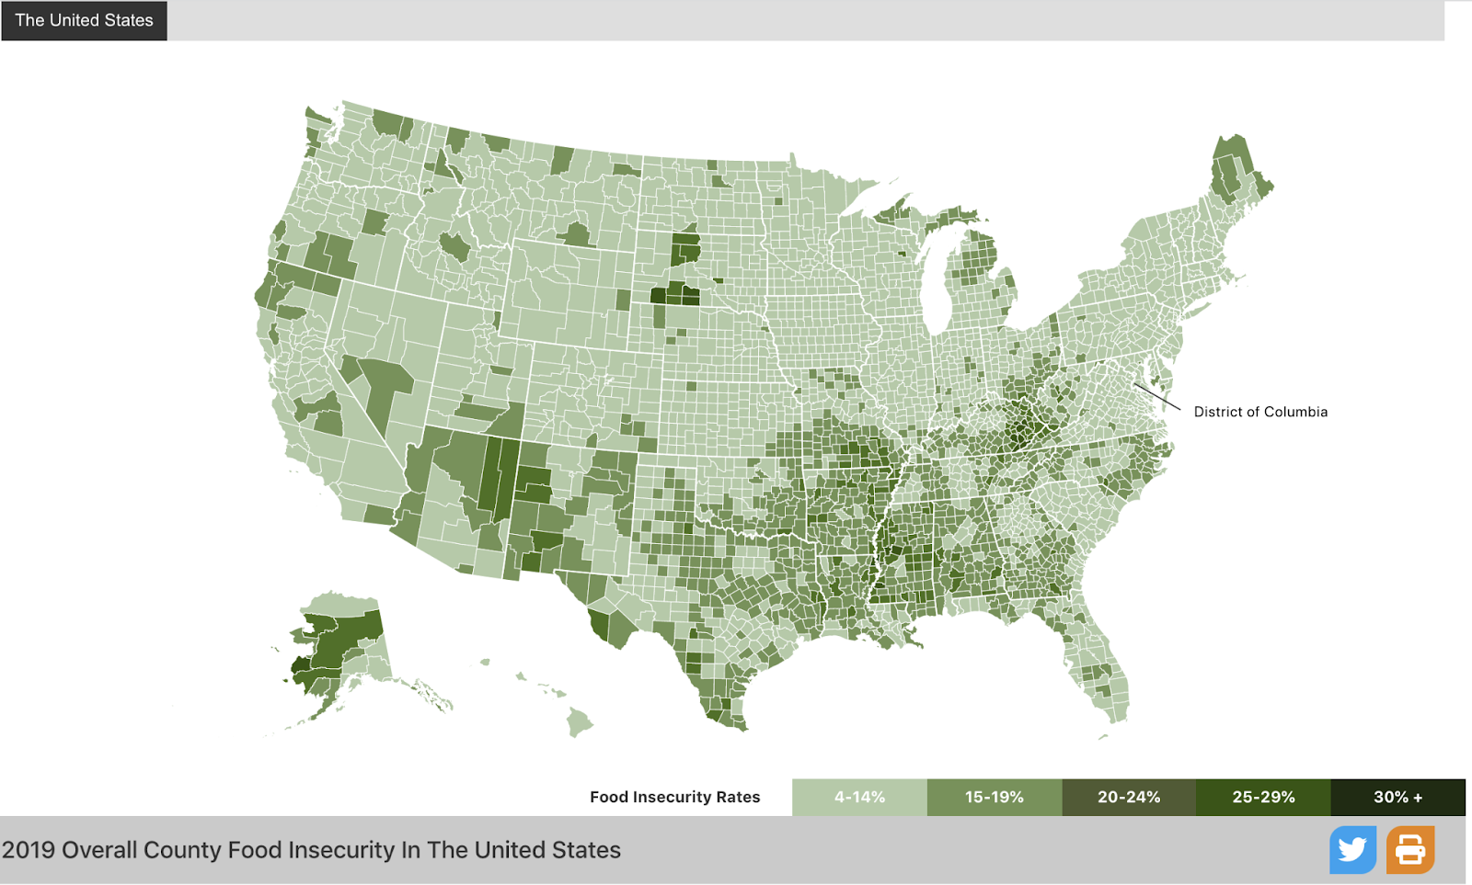
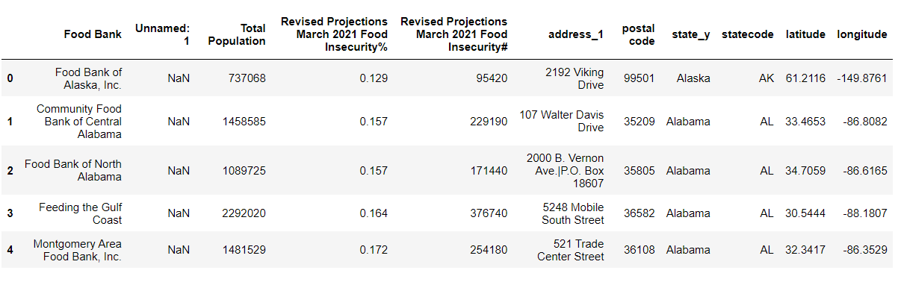
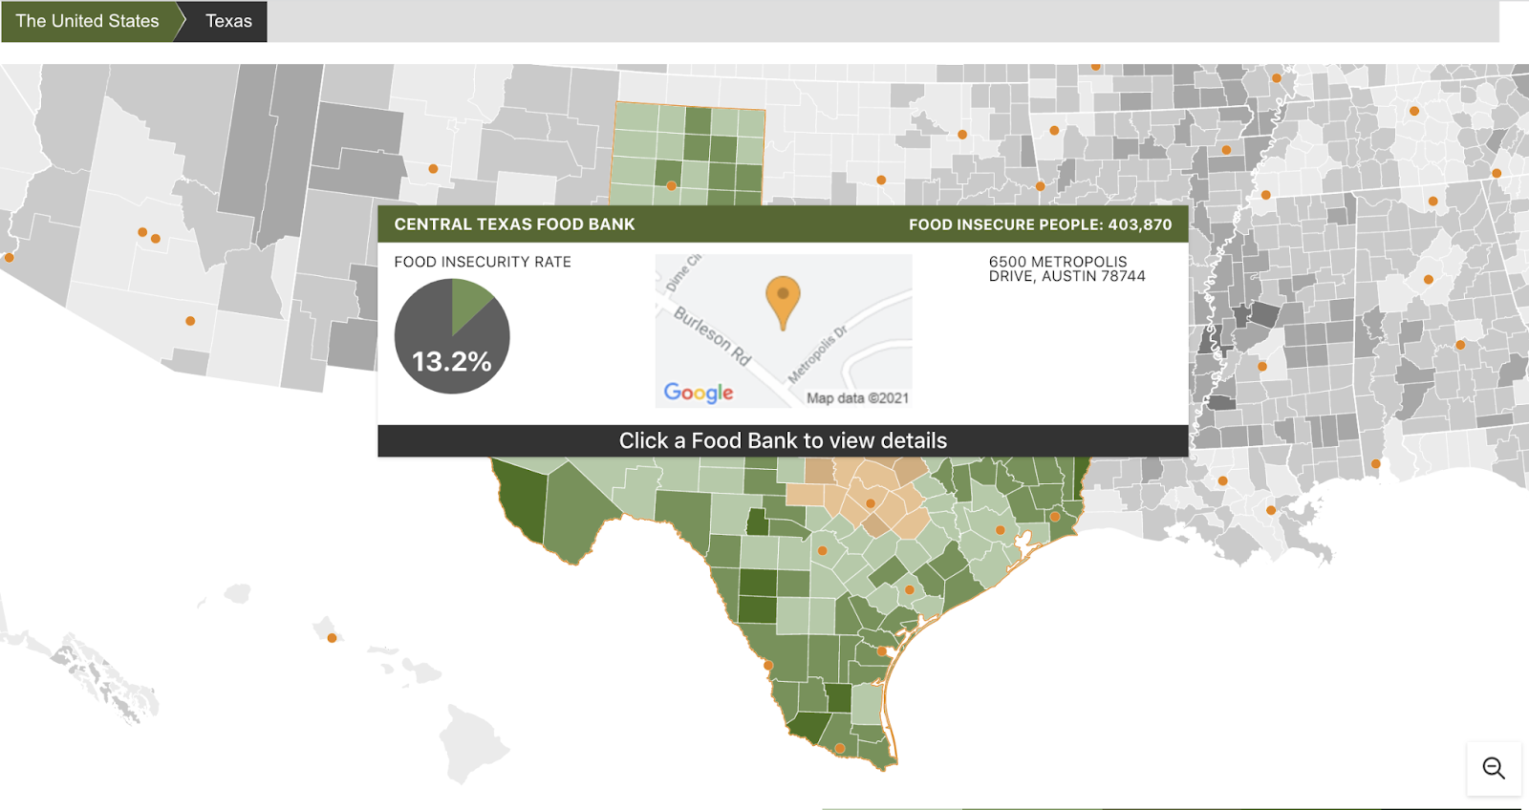
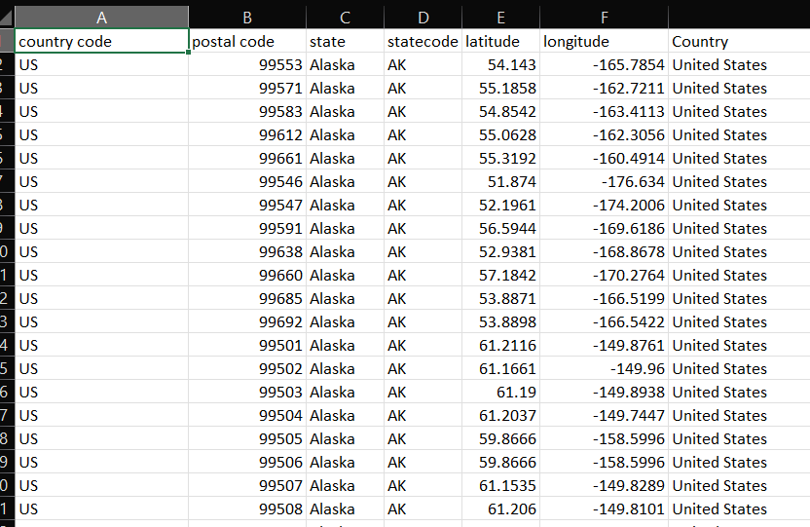
Web Scraping the dataset:

Slide 5
How? Hypothesis:
Hypothesis 1
The waste percent reduces by 30% if a food bank shares its surplus fresh produce with the neighbouring food banks.
Hypothesis 2
If one of the food banks couldn’t work due to regional damage from a disaster, they are able to fulfil the suddenly growing demand through the network. (in progress)

Slide 6
Simulation:
Assumptions
Variables used
Demo
output
Statistical results of waste percent

Slide 7
Simulation
Assumptions
Variables used
Demo
output

Slide 8
Assumptions & Random variables
Demand:
ppl_insecure = Total Population * Food insecurity percentage
demand = np.random.poisson(ppl_insecure * (1.6 / 7))
Poisson distribution
The primary grocery shopper in U.S. households made an average of 1.6 shopping trips per week in 2019 (source)
Supply:
ppl_potential_supply = Total Population * (1- Food insecurity percentage) * 50%
50% of food secure population are potential donors
supply = np.random.binomial(ppl_potential_supply, 0.1)
We assume each donor to donate food once per ten days

Slide 9
Assumptions & Random variables
Freshness: use shelf life to present freshness of any kind of food
If the food will spoiled in 3 three days, we denote as d3
When the food is in d0 at the end of the day, it becomes waste
Each person takes 1 unit of fresh food, and has preference d3>d2>d1>d0
Each donor donate 1 unit of fresh food and always provide d3

Slide 10
Plan next:
D
Connect with network graphs
add nodes of food banks with attributes of latitude, longitude, demand and supply
J
C
K
B
E
A
H
F
I
G

Slide 11
Plan next:
D
Connect with network graphs
add nodes of food banks with attributes of latitude, longitude, demand and supply
After calculating food bank A’s waste of fresh food, search other food banks in 200 km
J
C
K
B
200 km
E
A
H
F
I
G

Slide 12
Plan next:
D
Connect with network graphs
add nodes of food banks with attributes of latitude, longitude, demand and supply
After calculating food bank A’s waste of fresh food, search other food banks in 200 km
If any other food bank is in shortage, add an edge between them with attributes of (demand - supply) and distance.
J
C
K
B
200 km
E
A
H
F
I
G

Slide 13
Plan next:
D
Connect with network graphs
add nodes of food banks with attributes of latitude, longitude, demand and supply
After calculating food bank A’s waste of fresh food, search other food banks in 200 km
If any other food bank is in shortage, add an edge between them with attributes of (demand - supply) and distance.
Calculate the waste
J
C
K
B
200 km
E
A
H
F
I
G

Slide 14
thank you
Kinjal Shah
Candice Chen

